Slide 1

Welcome to CHESTNUTS
September 2025

Slide 2


Outline of this session:
- to meet your child’s new class teacher
- to share routines and expectations
- information about how you can help support at home
- how you can get in touch with us

Slide 3

Current position of school
We had a great year last building on lots of successes.
Data in all statutory areas – EYFS, Year 1 phonics check, Year 4 multiplication check and end of KS2 SATs results were all above local and national figures. This is a really strong position to be in.
From these successes, we are in a fantastic position to build and continue to improve!

Slide 4

School Priorities for 2025/26
To continue to develop and embed oracy skills across school.
To further embed the writing process, developing on transcription skills.
To develop SEND provision across school.

Slide 5
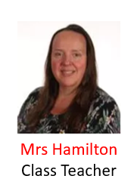
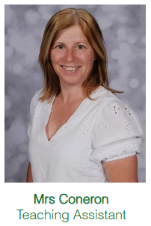
Meet the Team

Slide 6
Routines:
8.40 am – Mrs Bamforth will open the gates. Children to come to their classroom (Early Morning Task)
9am – 10 am Maths
10.00 am to 10.15 am Daily Assembly
10.15 Times tables
KS2 10.35am – Playtime
KS2 10.50am – Spelling
11.10am – Writing
11.50am – SQUIRT
12.15 pm – Lunch time
1pm – Foundation subjects/daily mile
3.15pm – Home time - children will be brought to the playground. Please note, only Year 6 can walk home and this needs to be confirmed in writing please.

Slide 7
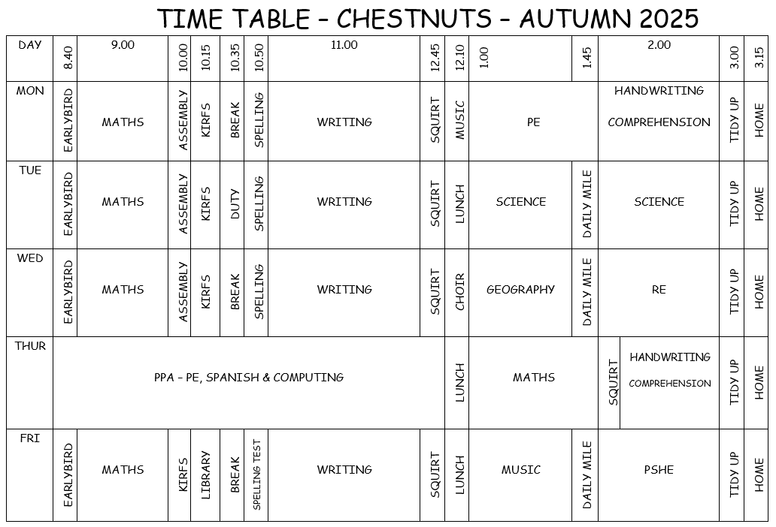
Chestnuts Timetable

Slide 8
Equipment
Please ensure that your child brings a water bottle to school everyday (they will be sent home every night so they can be kept clean).
Trainers are required in school every day.
PE kit is needed on a Monday and a Thursday (shorts, T-shirt, trainers, leggings or joggers and hoody or jumper for outdoor PE in the winter).
All stationery is provided by school. Please don’t send in a pencil case – keep it at home to use for homework.
Occasionally for DT projects we may ask children to bring in some resources.

Slide 9
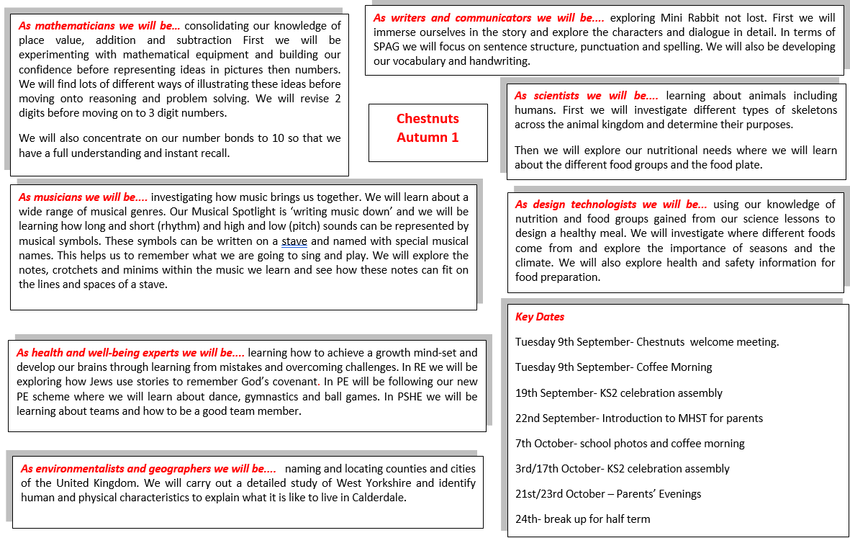
Curriculum Coverage

Slide 10
Homework
Sent out Friday
Hand in Wednesday
Reading
Spelling
Times tables
Writing

Slide 11
How you can help
Supporting with homework
Reading with your child – every day please!
Visiting the website for links
http://www.ripponden.calderdale.sch.uk/
Talking to your child about their learning
Keeping the lines of communication open – we have an open door policy and are here to help and support your child and your family where we can.

Slide 12
Medical/health needs
We hold a medical and health care needs register in school and this is treated with the strictest of confidence.
If your child has a medical need that we don’t know about, or if these needs change, please let us know as soon as possible. Please also make sure in date medication is sent into school.
To let us know, please email office@ripponden.calderdale.sch.uk for the attention of Miss Smith.

Slide 13
Any questions?
We are delighted to be able to meet face-to-face again. Please do ask if you have any questions.
If you have any questions about any of this, please get in touch with the office:
office@ripponden.calderdale.sch.uk
and a member of staff will get back to you as soon as possible.

