Slide 1
Welcome to Willows
September 2022

Slide 2
Outline of this session: - to meet your child’s new class teacher - to share routines and expectations - information about how you can help support at home - how you can get in touch with us

Slide 3
Current position of school
We have worked really hard with the children on a Covid recovery and facilitating a positive atmosphere in which the children have felt safe, happy and confident.
We have had statutory data for the first time in 3 years and we have been pleased with it, considering the gaps that we have been faced with. Statutory data is roughly in line with national average figures in most areas.
This year is the year, that with a greater focus on high quality teaching and learning, we will see the children continue to flourish and reach their full potential.

Slide 4
School Priorities for 2021/22
To develop the early language skills, acquisition and vocabulary.
To improve writing outcomes for all children.
To stretch and challenge all children, so potential of all children is met.

Slide 5
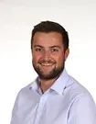
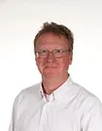
Meet the Team
Mr Hanlon
PPA Cover Tuesday Morning 8:30-9:15
Thursday Afternoon
Mr Baldwin
Class Teacher
Miss Dean
Teaching Assistant
Monday, Tuesday, Wednesday and Thursday mornings

Slide 6
Routines:
8.40 am – Mrs Bamforth will open the gates. Children to come to their classroom (Early Morning Task)
9am – 10 am Session 1
10.00 am to 10.15 am Daily Assembly
10.15 (X tables and Spelling)
KS2 10.35am – Playtime
KS2 10.50am – SQUIRT/Class Reading
11.15am – Session 2
12.15 pm – Lunch time
1pm – Foundation subjects/daily mile
3.15pm – Home time - children will be brought to the playground. Please note, only Year 6 can walk home and this needs to be confirmed in writing please.

Slide 7
Timetable

Slide 8
Expectations
Class Vision
Our classroom is a place of exciting discovery. We learn with great enthusiasm and resilience and support each other through our actions and words. We embrace the magic moments, and we aim to be outstanding role models for Ripponden J&I School!

Slide 9
Equipment
Monday: PE Kit
Tuesday: Trainers for the Daily Mile
Wednesday: Trainers for the Daily Mile
Thursday: PE kit
Friday: trainers for the Daily Mile

Slide 10
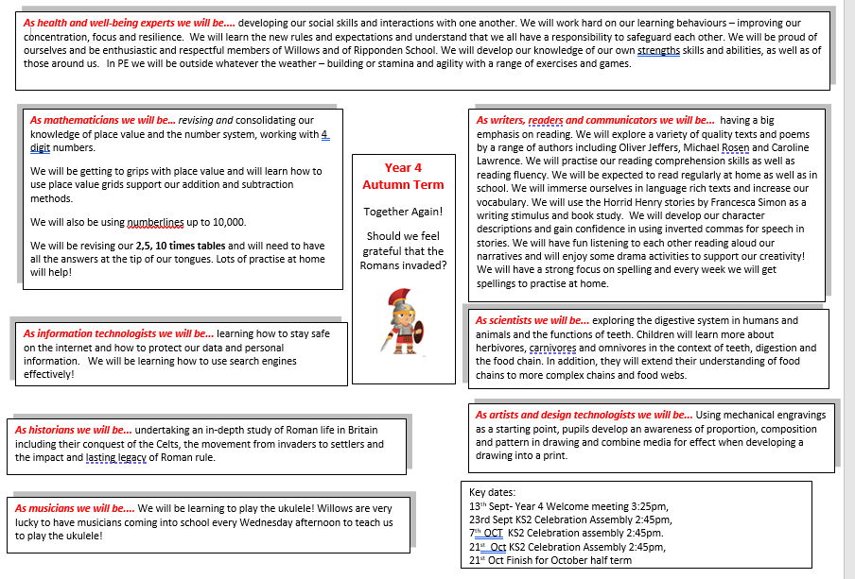
Curriculum Coverage

Slide 11
Homework
Homework will be set on a Thursday and is to be returned no later than the following Tuesday.
I will always set 1 piece of Maths Work
Most weeks will consist of 1 piece of English work however, some weeks English will be replaced with homework based on one of our other lessons!
Spellings will be given out on a Thursday with the spelling test being completed the following Thursday

Slide 12
How you can help
Supporting with homework
Reading with your child – every day please!
Visiting the website for links
http://www.ripponden.calderdale.sch.uk/
Talking to your child about their learning
Keeping the lines of communication open – we have an open door policy and are here to help and support your child and your family where we can.

Slide 13
Medical/health needs
We hold a medical and health care needs register in school and this is treated with the strictest of confidence.
If your child has a medical need that we don’t know about, or if these needs change, please let us know as soon as possible. Please also make sure in date medication is sent into school.
To let us know, please email office@ripponden.calderdale.sch.uk for the attention of Ms Gilmartin.

Slide 14
Any questions?
We are delighted to be able to meet face-to-face again. Please do ask if you have any questions.
If you have any questions about any of this, please get in touch with the office:
office@ripponden.calderdale.sch.uk
and a member of staff will get back to you as soon as possible.

