Slide 1

Welcome to Willows
September 2025

Slide 2


Outline of this session:
- to meet your child’s new class teacher
- to share routines and expectations
- information about how you can help support at home
- how you can get in touch with us

Slide 3

Current position of school
We had a great year last building on lots of successes.
Data in all statutory areas – EYFS, Year 1 phonics check, Year 4 multiplication check and end of KS2 SATs results were all above local and national figures. This is a really strong position to be in.
From these successes, we are in a fantastic position to build and continue to improve!

Slide 4

School Priorities for 2025/26
To continue to develop and embed oracy skills across school.
To further embed the writing process, developing on transcription skills.
To develop SEND provision across school.

Slide 5
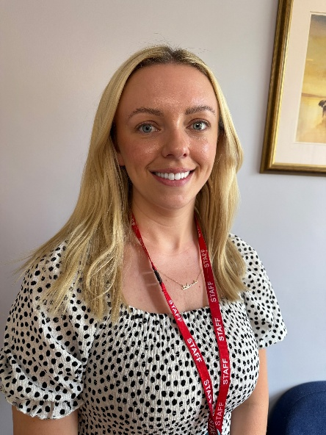
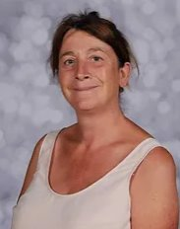
Meet the Team
Mrs. Beaumont – Willows Class Teacher
Mrs. Whitely – alternate Wednesday afternoons cover
Miss. Donnely
Miss. Beazely
Mrs. Coneron
Mrs. Fearnley

Slide 6

Meet the Team
Thursdays on Willows class – Junior Jam
PE, computing and spanish

Slide 7
Routines:
8:40-9:00: Morning Task
9:05-10:00- Lesson 1
10:00-10:15 - Assembly
10:35-10:50 - Playtime
10:30-11:30- SQUIRT
11:30 - Lesson 2
12:15 - Lunch Time
1-2:00 - Lesson 3
2:00-2:15- Daily Mile (Monday, Tuesday, Wednesday)
2:15-3:15- Lesson 4
3:15- Home Time

Slide 8
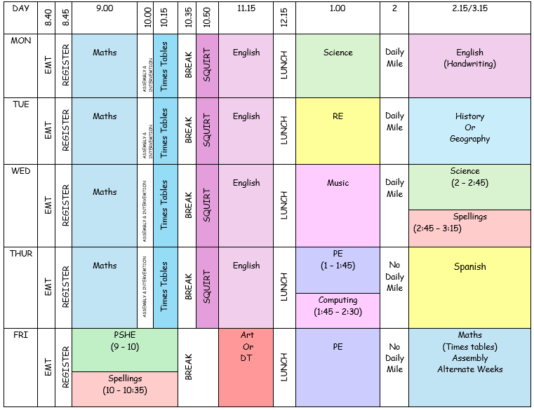
Willows Timetable

Slide 9

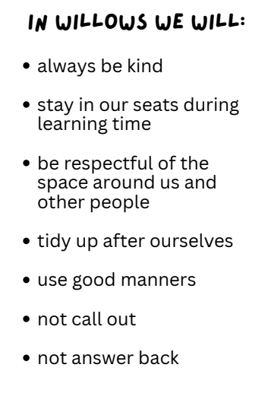
Expectations

Slide 10
Equipment
Please ensure that your child brings a water bottle to school everyday (they will be sent home every night so they can be kept clean).
Trainers are required in school every day.
PE kit is needed on a Thursday and a Friday (shorts, T-shirt, trainers, leggings or joggers and hoody or jumper for outdoor PE in the winter).
All stationery is provided by school. Please don’t send in a pencil case – keep it at home to use for homework.
Occasionally for DT projects we may ask children to bring in some resources.

Slide 11
Assessments
The multiplication tables check (MTC) is statutory for all year 4 pupils in England.
The purpose of the MTC is to determine whether pupils can recall their times tables fluently, which is essential for future success in mathematics.
It will help schools to identify pupils who have not yet mastered their times tables, so that additional support can be provided. The Department for Education also publishes statistics on MTC attainment.
This assessment must be done within the first 2 weeks in June – date TBC.

Slide 12
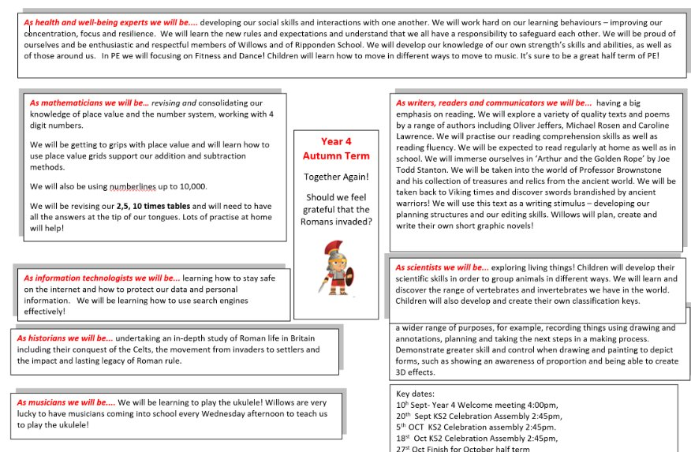
Curriculum Coverage

Slide 13
Homework
Homework in year 4 will be handed out on a Friday and must be returned by Tuesday please.
On top of this, please encourage children to read daily at home and practice times tables.
A great resource for times tables is the website
Hit the button.

Slide 14
How you can help
Supporting with homework
Reading with your child – every day please!
Visiting the website for links
http://www.ripponden.calderdale.sch.uk/
Talking to your child about their learning
Keeping the lines of communication open – we have an open door policy and are here to help and support your child and your family where we can.

Slide 15
Medical/health needs
We hold a medical and health care needs register in school and this is treated with the strictest of confidence.
If your child has a medical need that we don’t know about, or if these needs change, please let us know as soon as possible. Please also make sure in date medication is sent into school.
To let us know, please email office@ripponden.calderdale.sch.uk for the attention of Miss Smith.

Slide 16
Any questions?
We are delighted to be able to meet face-to-face again. Please do ask if you have any questions.
If you have any questions about any of this, please get in touch with the office:
office@ripponden.calderdale.sch.uk
and a member of staff will get back to you as soon as possible.

