Slide 1
Welcome to Redwoods
September 2023

Slide 2
Outline of this session: - to meet your child’s new class teacher - to share routines and expectations - information about how you can help support at home - how you can get in touch with us

Slide 3
Current position of school
The school went through a very rigorous Ofsted inspection in April and retained our ‘Good’ judgement.
In terms of data, the EYFS data is the strongest it has ever been and above local and national figures.
Year 4 Multiplication scores were significantly above national figures.
Outcomes at Key Stage 1 and Key Stage 2 are also very strong, with really good progress across Key Stage 1, and were at least in line with local and national figures and in some areas above.
We are in a great position to build on these successes this year!

Slide 4
School Priorities for 2023/24
To continue to improve writing outcomes for all children.
To develop oracy across the school.
To refine the mapping and development of the foundation subjects.

Slide 5
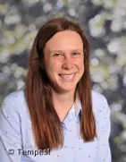
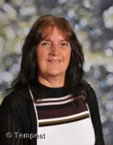
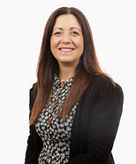
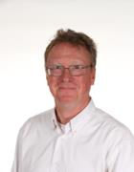
Meet the Team
Mrs Lomas
Year 6 Class Teacher
Mrs Thompson
Year 6 Teaching Assistant
Mrs Rosa Calcott
Support Assistant
Mr Hanlon
HLTA

Slide 6
Routines:
8:40 – 8:45 Start of school day (soft start)
8:40 – 8:55 Early morning work
8:55 – 10.00 Maths
10:00 – 10:15 Assembly (interventions)
10:15 – 10.35 SQUIRT
10:35 – 10:50 Break
10:50 – 12:15 English
12:15 – 1:00 Lunch
1:00 – 2:00 session 3
2:00 – 2:15 Daily Mile (when no PE)
2:15 – 3:15 session 4
3:15 - Home

Slide 7
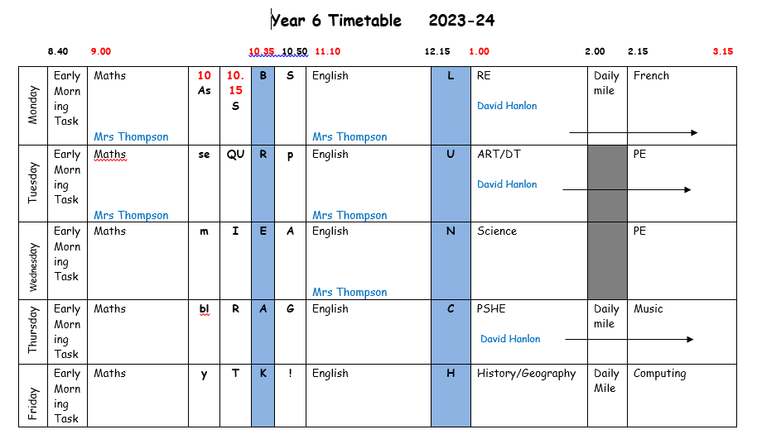
Redwoods’ Timetable

Slide 8
Equipment
Please ensure that your child brings a water bottle to school everyday (they will be sent home every night so they can be kept clean).
Trainers are required in school every day.
PE kit is needed on a Tuesday and a Wednesday (shorts, T-shirt, trainers, leggings or joggers and hoody or jumper for outdoor PE in the winter).
All stationery is provided by school. Please don’t send in a pencil case – keep it at home to use for homework.
Occasionally for DT projects we may ask children to bring in some resources.

Slide 9
Year 6 and end of KS2 assessments
Year 6 pupils will still be sitting their SATs tests in the second full week of May 2024. (13th – 16th May)
In English there will be a reading test, a spelling test and a grammar and punctuation test. Writing is teacher assessed throughout the year.
In maths there are three papers (Arithmetic and two reasoning papers).
Throughout the year, the children will practise using old SATs papers to enable us to see where they are, as well as to get them used to the format of the tests. SATs papers are an assessment of the whole of KS2.

Slide 10
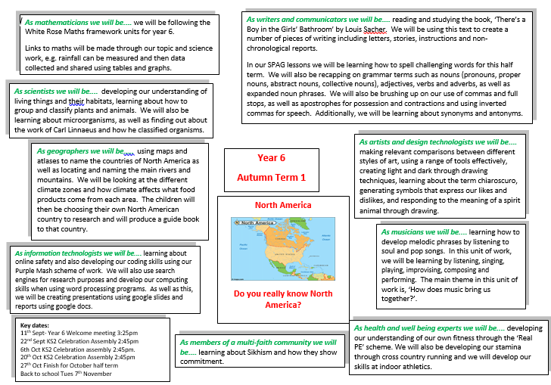
Curriculum Coverage

Slide 11
Homework
Spellings – new spellings will be given out on a Friday and then tested the following Friday. It’s a good idea to keep the sheet at home for the whole week so the spellings can be practised every day.
Reading – the class text will be sent home on a Friday with reading to be completed over the weekend. The book MUST be returned on Monday and is needed in school every day.
Later in the year, the book may also be sent home on Monday with reading to complete for Friday.
Maths – Handed out on a Friday to be in by the following Wednesday.

Slide 12
How you can help
Supporting with homework
Reading with your child – every day please!
Visiting the website for links
http://www.ripponden.calderdale.sch.uk/
Talking to your child about their learning
Keeping the lines of communication open – we have an open door policy and are here to help and support your child and your family where we can.

Slide 13
Children’s use of social media and messaging platforms
In school we are having to deal with an increasing amount of problems between children and families due to messaging on these platforms out of school hours.

Slide 14
Medical/health needs
We hold a medical and health care needs register in school and this is treated with the strictest of confidence.
If your child has a medical need that we don’t know about, or if these needs change, please let us know as soon as possible. Please also make sure in date medication is sent into school.
To let us know, please email office@ripponden.calderdale.sch.uk for the attention of Miss Smith.

Slide 15
Any questions?
We are delighted to be able to meet face-to-face again. Please do ask if you have any questions.
If you have any questions about any of this, please get in touch with the office:
office@ripponden.calderdale.sch.uk
and a member of staff will get back to you as soon as possible.

