Slide 1
Welcome to Great Oaks!
September 2023

Slide 2
Outline of this session: - to meet your child’s new class teacher - to share routines and expectations - information about how you can help support at home - how you can get in touch with us

Slide 3
Current position of school
The school went through a very rigorous Ofsted inspection in April and retained our ‘Good’ judgement.
In terms of data, the EYFS data is the strongest it has ever been and above local and national figures.
Year 4 Multiplication scores were significantly above national figures.
Outcomes at Key Stage 1 and Key Stage 2 are also very strong, with really good progress across Key Stage 1, and were at least in line with local and national figures and in some areas above.
We are in a great position to build on these successes this year!

Slide 4
School Priorities for 2023/24
To continue to improve writing outcomes for all children.
To develop oracy across the school.
To refine the mapping and development of the foundation subjects.

Slide 5
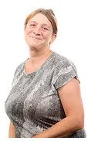
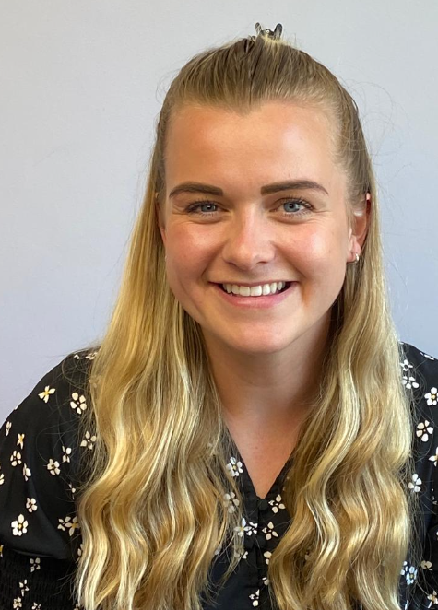
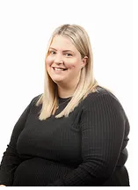
Meet the Team
Miss Chloe Callistar
Teaching Assistant
Tues and Thurs AM
PPA Cover/TA Mon and Fri
Mrs Whiteley
Miss Lily Smith
Class Teacher

Slide 6
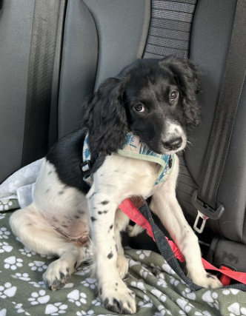
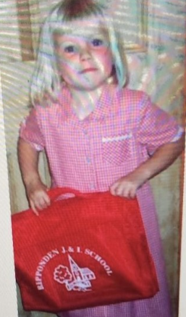
A bit about me!
I have been teaching six years and have experience in Early Years and Key Stage 1.
I came to Ripponden J&I School as a little girl.
I have a puppy called Rosie.
I enjoy running and spending time with my family.
I will always be there to help!
Miss Lily Smith
Class Teacher

Slide 7
Routines:
8.40 am – Mrs Bamforth will open the gates. Children to come to their classroom (Early Morning Task)
9am – 10 am Session 1- Maths
10.00 am to 10.15 am Daily Assembly
10.15 Playtime
10.35am – Phonics/Reading Group sessions
11.15am – Session 2
12.15 pm – Lunch time
1pm – Foundation subjects/daily mile
3.15pm – Home time - children will be brought to the playground. If you need to speak to myself or another adult dismissing, please wait until we have released most children. Thank you.

Slide 8
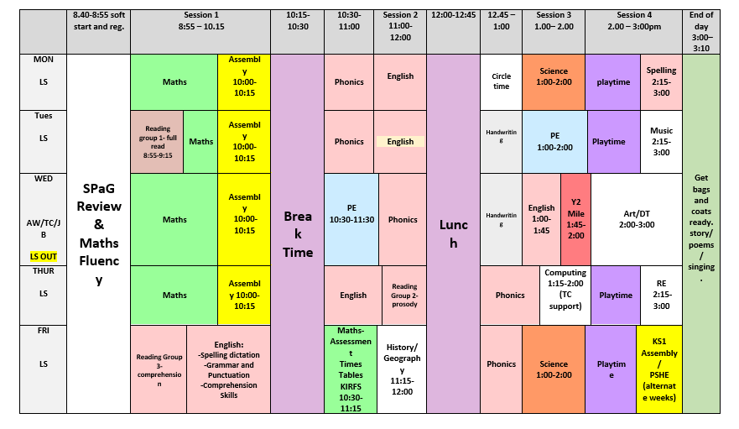
Timetable

Slide 9
Expectations
Our Class Vision

Slide 10
Equipment
PE Kits- Tuesday and Wednesday
Reading Books- Bring back on a Friday.
Please keep bag sizes to a minimum- coats will not fit in the lockers with large bags, and we do not have any other storage. Children should be bringing coats, a small bag and PE kit, nothing else.
Thank you.

Slide 11
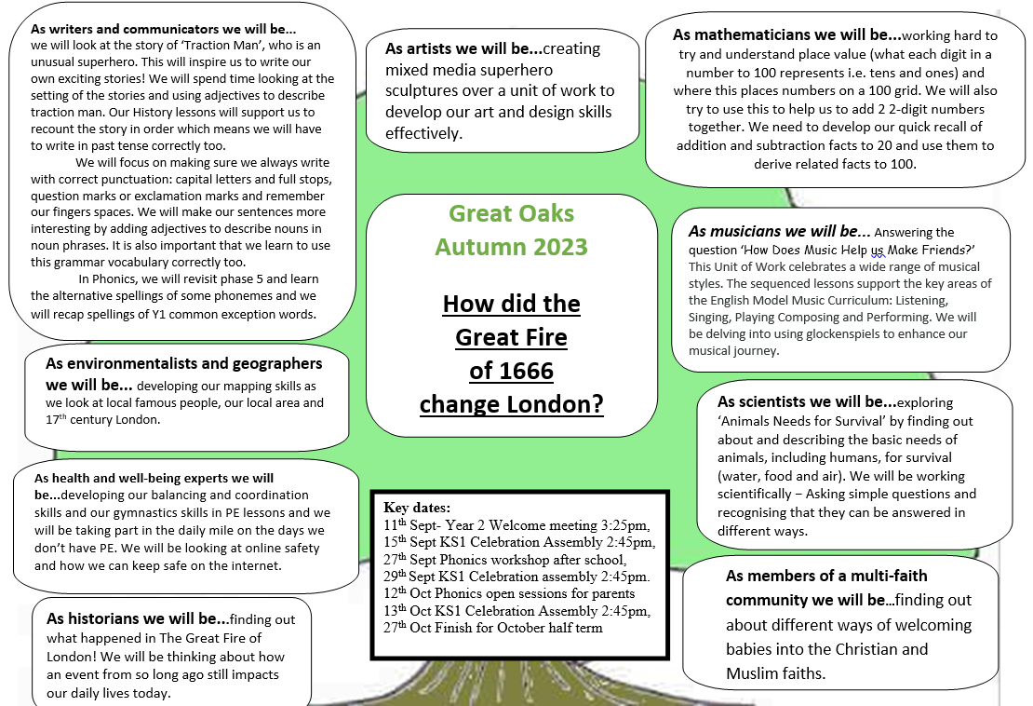
Curriculum Coverage

Slide 12
Homework
Maths and Spellings (after October half term)- Sent home on a Friday, returned on a Wednesday.
Reading Books: Sent home on a Friday, returned the following Friday.

Slide 13
How you can help
Supporting with homework
Reading with your child – every day please!
Visiting the website for links
http://www.ripponden.calderdale.sch.uk/
Talking to your child about their learning
Keeping the lines of communication open – we have an open door policy and are here to help and support your child and your family where we can.

Slide 14
Medical/health needs
We hold a medical and health care needs register in school and this is treated with the strictest of confidence.
If your child has a medical need that we don’t know about, or if these needs change, please let us know as soon as possible. Please also make sure in date medication is sent into school.
To let us know, please email office@ripponden.calderdale.sch.uk for the attention of Miss Smith.

Slide 15
Any questions?
We are delighted to be able to meet face-to-face again. Please do ask if you have any questions.
If you have any questions about any of this, please get in touch with the office:
office@ripponden.calderdale.sch.uk
and a member of staff will get back to you as soon as possible.

