Slide 1
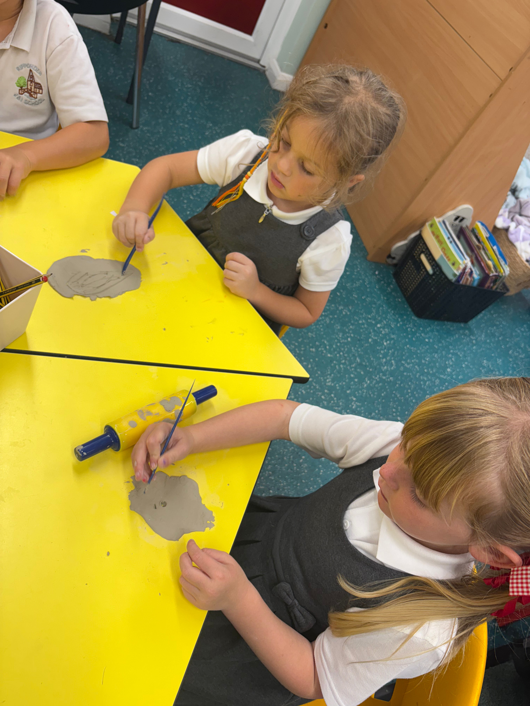

Welcome
To Saplings!

Slide 2
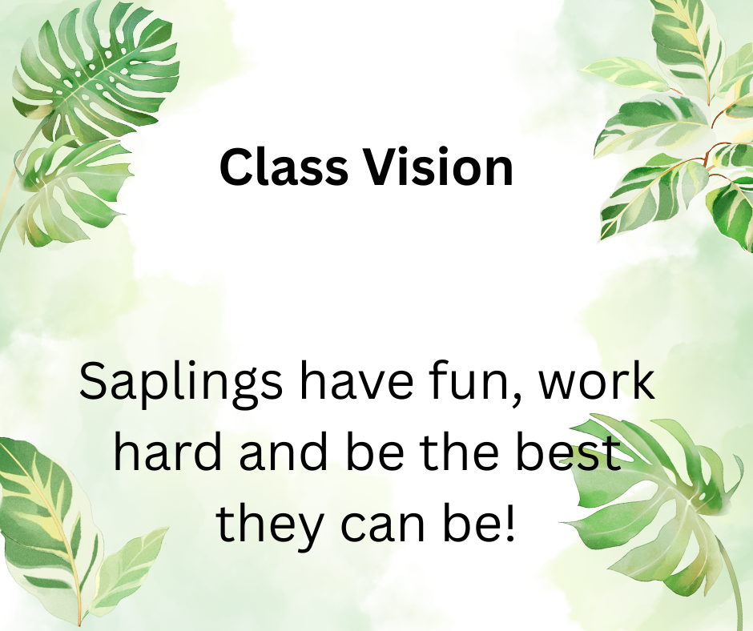

Slide 3

A little bit about me…
I’m Miss Wisniewski, and this is my third year of teaching Year 1. I can honestly say, I’ve definitely hit the jackpot with this year group as they progress so much not only as little learners but people too! I like to make sure our classroom is a safe and welcoming place for every child, where we work hard, support one another, and most importantly - laugh every single day!

Slide 4

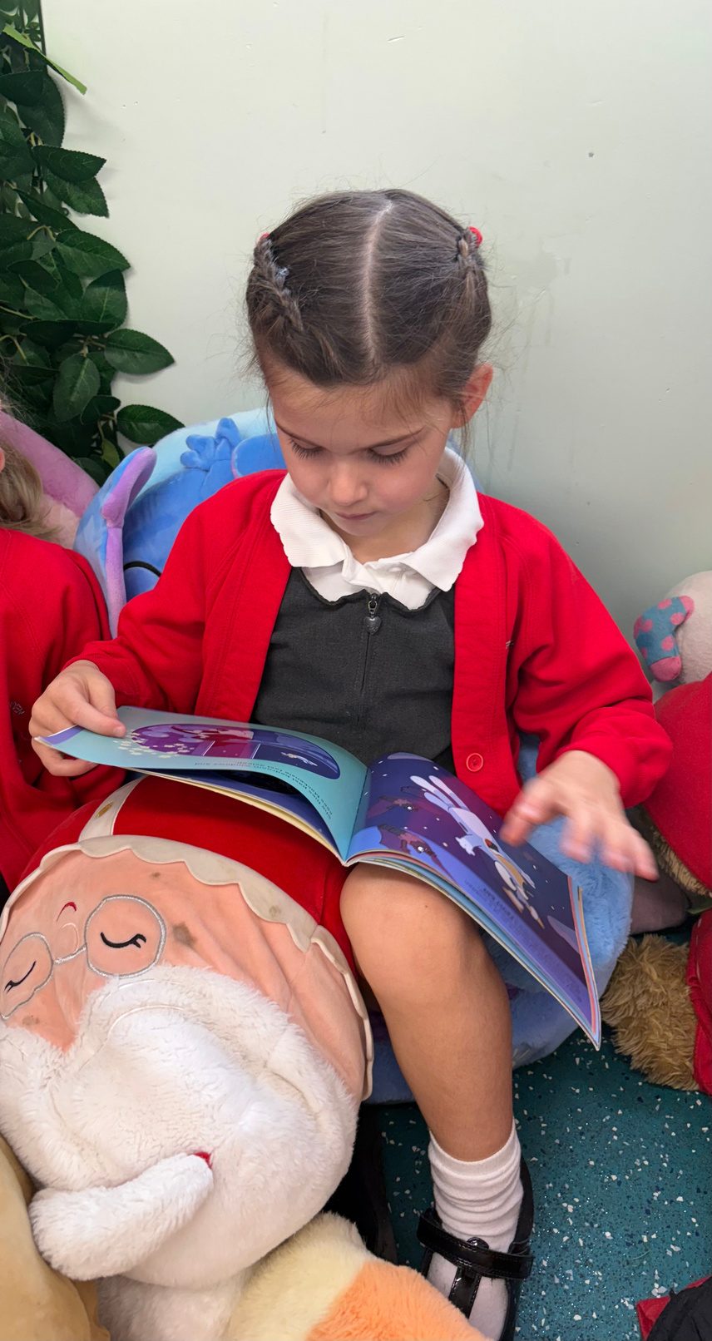

Last year was a really successful one for our school, with lots to celebrate. In every statutory area — EYFS, the Year 1 phonics check, the Year 4 multiplication check, and the end of KS2 SATs — our results were above both local and national figures. That’s something we can all be proud of! It puts us in a fantastic position to build on this success and keep moving forward together
Current
Position

Slide 5
School
Priorities
-To continue to develop and embed oracy skills across school.
- To further embed the writing process, developing on transcription skills.
- To develop SEND provision across school.
Notes:
1. Developing Oracy Skills
“We’re really focusing on helping children become confident speakers and good listeners. This means giving them lots of opportunities to share their ideas, explain their thinking, and take part in discussions. Strong oracy skills don’t just help with learning in the classroom — they also build confidence, friendships, and future life skills.”
2. Strengthening Writing Skills
“In writing, we’re continuing to build those essential building blocks like handwriting, spelling, and sentence structure, while also encouraging creativity and a love of writing. By giving children a clear writing process to follow — from planning, drafting, editing and improving — we’re helping them become more independent and resilient writers.”
3. Developing SEND Provision
“We’re committed to making sure every child, whatever their needs, has the right support to thrive. This year we’re strengthening the way we support children with additional needs, making sure strategies are in place across the whole school so that all children can access learning and make great progress.”

Slide 6
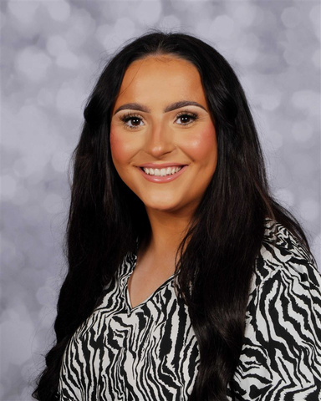
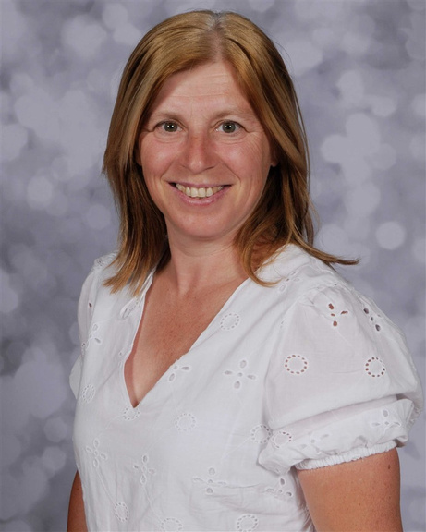
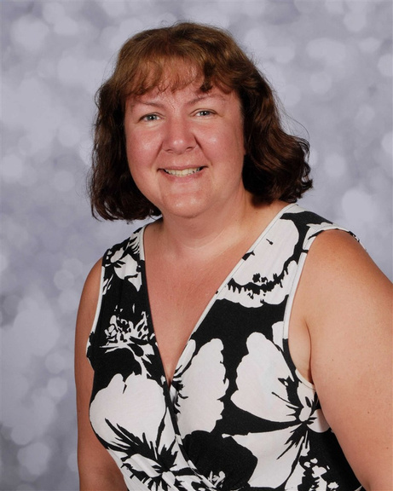
Meet Our
Team
Miss Wisniewski
Mrs Coneron
Mrs Greenwood

Slide 7

When is
PE?
Tuesday
Thursday

Slide 8
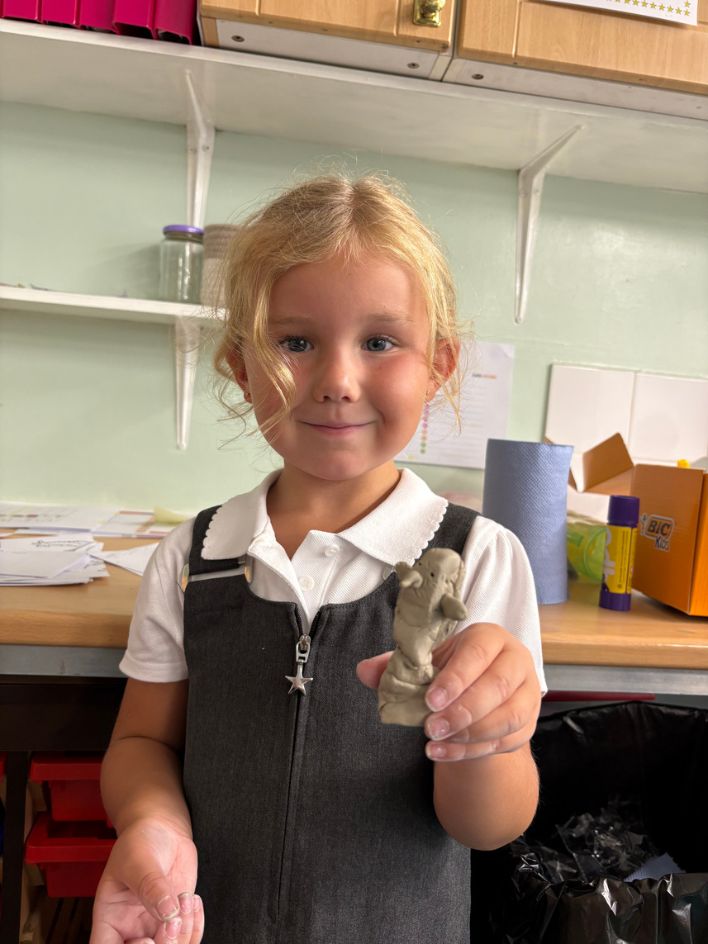
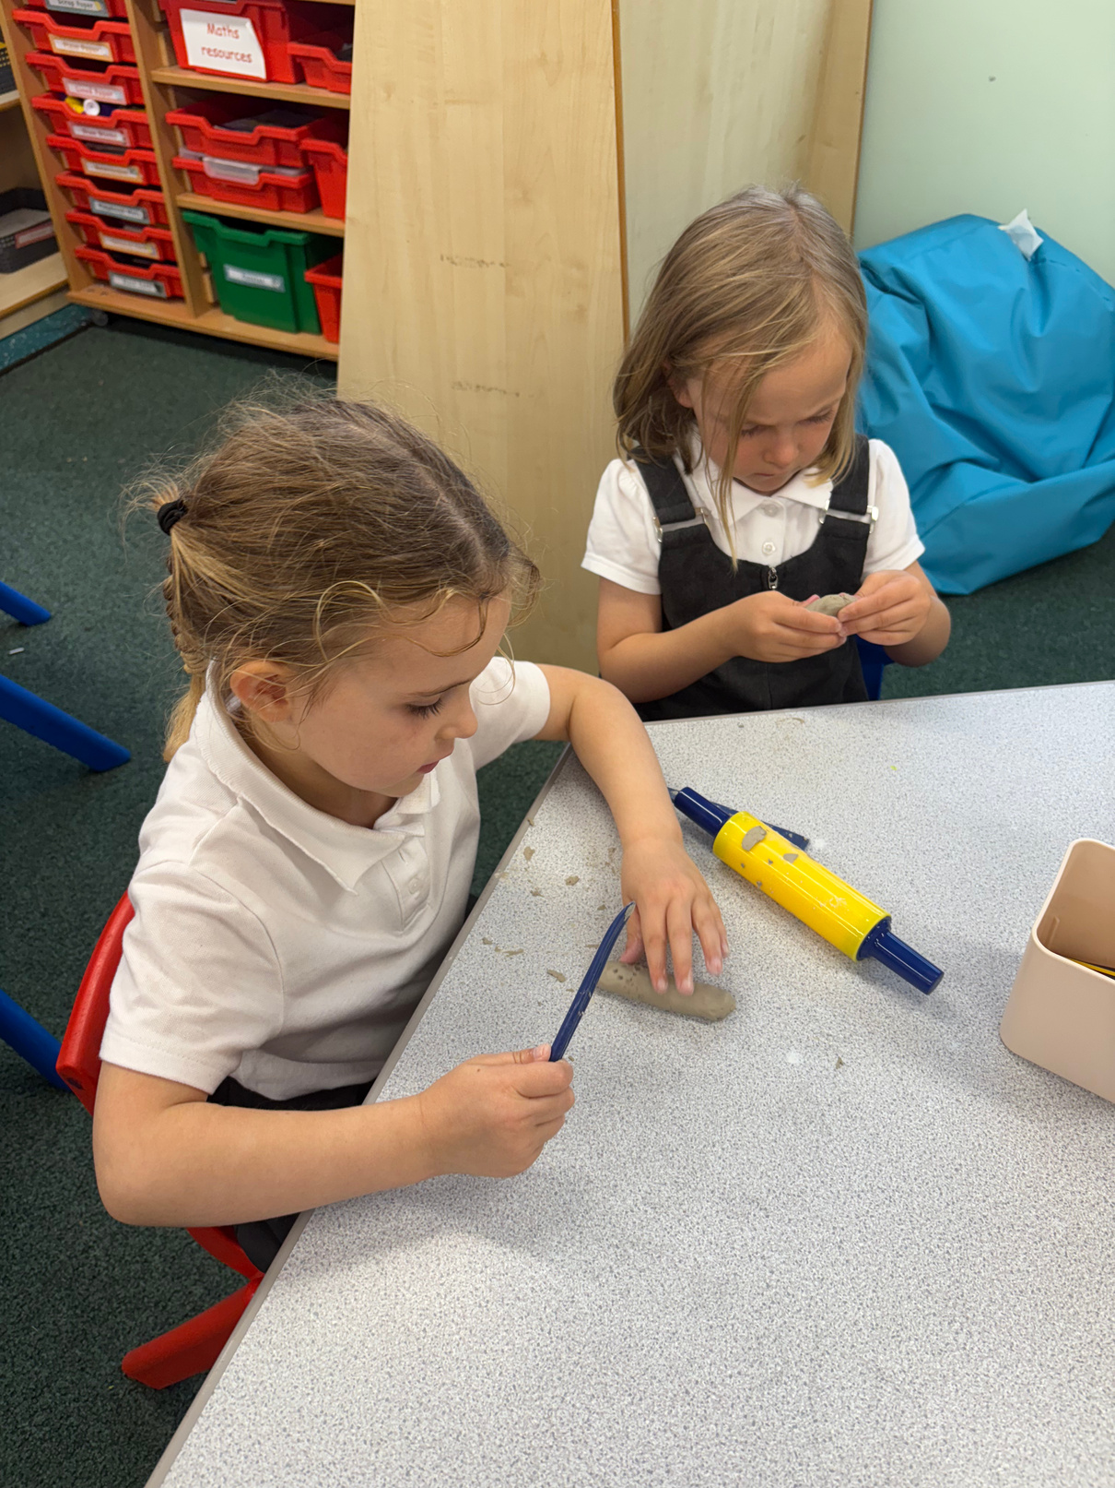
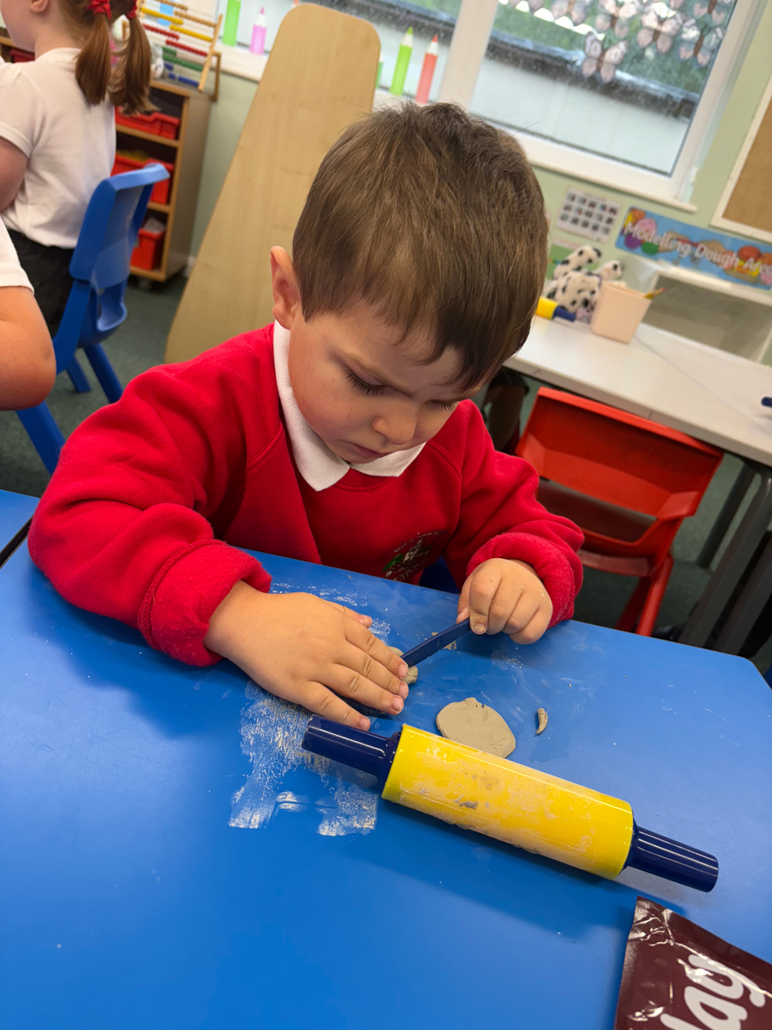
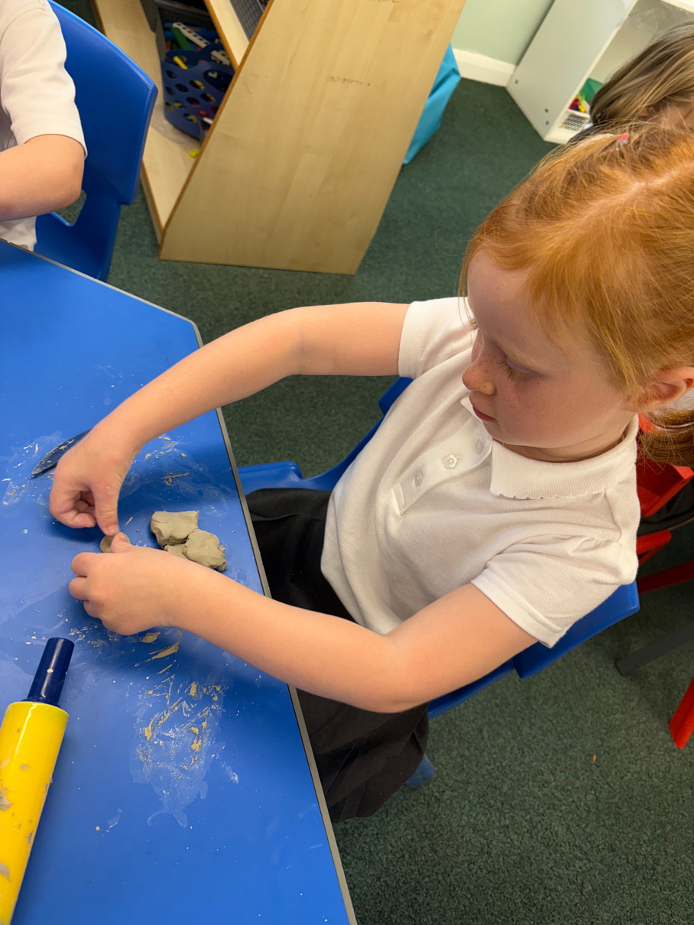
A Day in the Life
of Your Child in Year 1
8:40-9 Morning task
9-9:55 Session 1
10-10:15 Assembly
10:15-10:30 Break time
10:30-11:30 Session 2
11:30-12 Session 3
12-12:45 Lunch time
12:45-2 session 4
2-2:15 Break time
2:15-3 session 5
3-3:10 story / home time

Slide 9

How to survive
as a Year 1 parent
  Don’t panic when your child says “we did nothing today.”
2. Label EVERYTHING
2. Label EVERYTHING!
3. Remember: tiredness is real.

Slide 10

Phonics
Screening
  June 2026
Year 1 phonics assessment, children will read 40 words that are a mix of real worlds and nonsense words (alien words). The pass mark is usually around 32/40 but this can change.
Please don’t worry about this! We do lots of work in school to help prepare the children as best we can.

Slide 11


Reading books
Each Friday, your child will bring home a new reading book (Little Wandle) and a library book to enjoy. To help us keep the ‘swap’ system running smoothly, please make sure their previous book is returned on Friday so we can send a new one home in time for the weekend. If a book isn’t returned, we’ll need to wait until it comes back before giving out the next one.

Slide 12

Medical / Health needs
We hold a medical and health care needs register in school and this is treated with the strictest of confidence. If your child has a medical need that we don't know about, or if these needs change, please let us know as soon as possible. Please also make sure in date medication is sent into school.
To let us know, please email
office@ripponden.calderdale.sch.uk for the attention of Miss Smith.

Slide 13

How can you help?
  Read with your child every day—it’s the best kind of daily habit and we do see the difference in those that ready daily!
  Pop onto our website for useful links: Ripponden Primary Website
  Chat with your child about what they’re learning—you’ll be amazed at what they can teach you!
  Keep the conversation flowing—we have an open-door policy, so please don’t hesitate to reach out. We’re here to support your child and your family in any way we can.

Slide 14
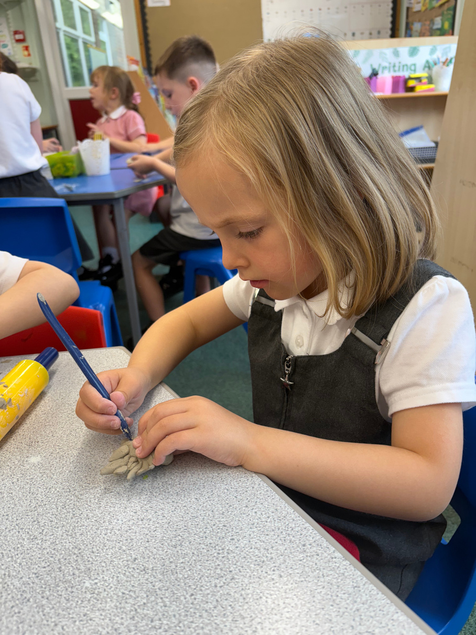
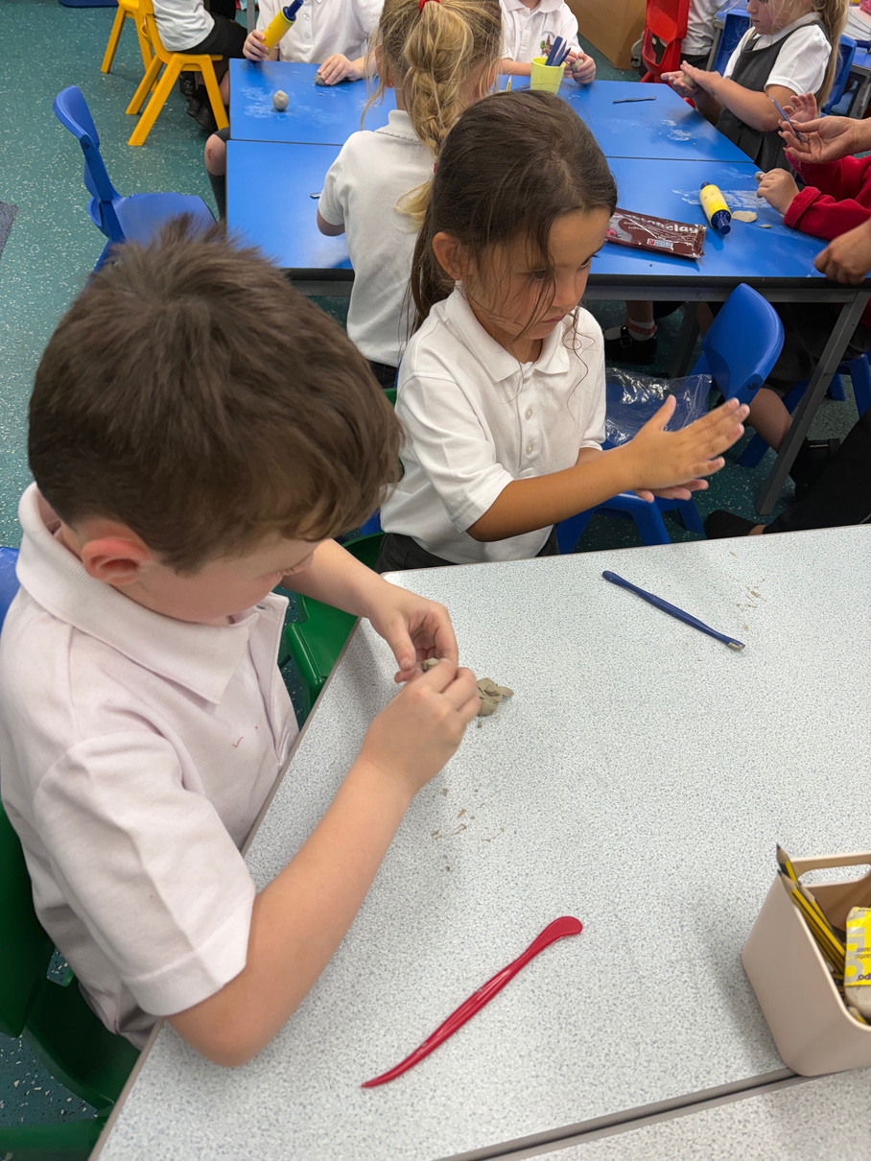
Any questions?
If you think of any after this meeting, please feel free to email the office: office@ripponden.calderdale.sch.uk and a member of staff will get back to you!

