Slide 1
Welcome to Chestnuts
September 2023

Slide 2
Outline of this session: - to meet your child’s new class teacher - to share routines and expectations - information about how you can help support at home - how you can get in touch with us

Slide 3
Current position of school
The school went through a very rigorous Ofsted inspection in April and retained our ‘Good’ judgement.
In terms of data, the EYFS data is the strongest it has ever been and above local and national figures.
Year 4 Multiplication scores were significantly above national figures.
Outcomes at Key Stage 1 and Key Stage 2 are also very strong, with really good progress across Key Stage 1, and were at least in line with local and national figures and in some areas above.
We are in a great position to build on these successes this year!

Slide 4
School Priorities for 2023/24
To continue to improve writing outcomes for all children.
To develop oracy across the school.
To refine the mapping and development of the foundation subjects.

Slide 5
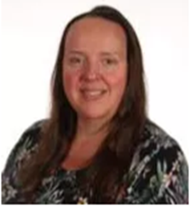
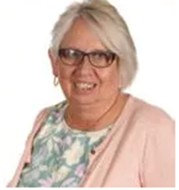
Meet the Team
Mrs Hamilton
Class Teacher
Josie Blair
Teaching Assistant
Mornings
Mr Hanlon
PPA Cover Friday morning

Slide 6
Routines:
8.40 am – Mrs Bamforth will open the gates. Children to come to their classroom (Early Morning Task)
9am – Maths
10.00 am – Daily Assembly
10.15 am – Spelling
KS2 10.35am – Playtime
KS2 10.50am – English
11.40am – Reading
12.15 pm – Lunch time
1pm – Foundation subjects/daily mile
3.15pm – Home time - children will be brought to the playground. Please note, only Year 6 can walk home and this needs to be confirmed in writing please.

Slide 7
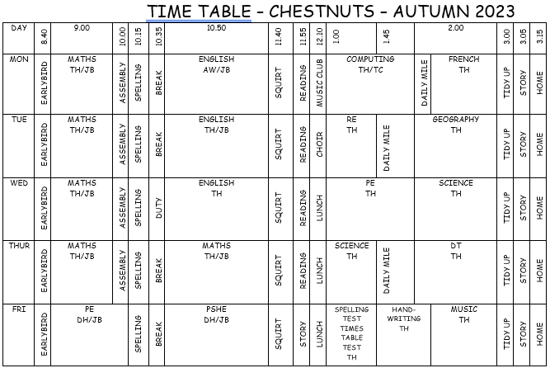
Timetable

Slide 8
Expectations
Calm and quiet atmosphere
Enthusiastic about learning
Listen carefully
Try our best
Don’t give up easily
Be respectful
DOJO points
Grove awards
Class target and reward

Slide 9
Equipment
Water bottle with water not juice
Waterproof coat with a hood every day
Trainers every day for Daily Mile
PE Kit – Wednesday and Friday – indoor (black shorts and red top) – outdoor (black joggers and red hoodie) – bobble for long hair – no jewellery including earrings – make sure children can tie their shoe laces
Fruit – a piece or handful of fruit – no snack bars
Everything named
No toys or stationery from home

Slide 10
Curriculum Coverage

Slide 11
Homework
Sent out Friday
Hand in Wednesday
Reading
Spelling
Times tables
Writing

Slide 12
How you can help
Supporting with homework
Reading with your child – every day please!
Visiting the website for links
http://www.ripponden.calderdale.sch.uk/
Talking to your child about their learning
Keeping the lines of communication open – we have an open door policy and are here to help and support your child and your family where we can.

Slide 13
Medical/health needs
We hold a medical and health care needs register in school and this is treated with the strictest of confidence.
If your child has a medical need that we don’t know about, or if these needs change, please let us know as soon as possible. Please also make sure in date medication is sent into school.
To let us know, please email office@ripponden.calderdale.sch.uk for the attention of Miss Smith.

Slide 14
Any questions?
We are delighted to be able to meet face-to-face again. Please do ask if you have any questions.
If you have any questions about any of this, please get in touch with the office:
office@ripponden.calderdale.sch.uk
and a member of staff will get back to you as soon as possible.

