Slide 1
Welcome to Saplings
September 2023

Slide 2
Outline of this session: - to meet your child’s new class teacher - to share routines and expectations - information about how you can help support at home - how you can get in touch with us

Slide 3
Current position of school
The school went through a very rigorous Ofsted inspection in April and retained our ‘Good’ judgement.
In terms of data, the EYFS data is the strongest it has ever been and above local and national figures.
Year 4 Multiplication scores were significantly above national figures.
Outcomes at Key Stage 1 and Key Stage 2 are also very strong, with really good progress across Key Stage 1, and were at least in line with local and national figures and in some areas above.
We are in a great position to build on these successes this year!

Slide 4
School Priorities for 2023/24
To continue to improve writing outcomes for all children.
To develop oracy across the school.
To refine the mapping and development of the foundation subjects.

Slide 5
Meet the Team
 | MORNING | AFTERNOON
MONDAY | Miss Wisniewski Mrs Coneron | Miss Wisniewski
TUESDAY | Mrs Whiteley Mrs Coneron | Mrs Whiteley Mrs Coneron
WEDNESDAY | Miss Wisniewski Mrs Coneron Mrs Greenwood (from 10:30) | Miss Wisniewski
THURSDAY | Miss Wisniewski Mrs Coneron Mrs Greenwood (from 10:30) | Miss Wisniewski
FRIDAY | Miss Wisniewski Mrs Coneron Mrs Greenwood (from 10:30) | Miss Wisniewski

Slide 6
Routines:
8.40 am – Mrs Bamforth will open the gates. Children to come to their classroom (Early Morning Task)
9am – 10 am Session 1
10.00 am to 10.15 am Daily Assembly
10.15am Playtime
10.30am – Session 2
11.15am – Session 2
12 pm – Lunch time
1pm – Foundation subjects/daily mile
3.10pm – Home time - children will be brought to the playground and lined up against the green fence. Parents must collect their child from the fence once they’re at the front of the line.

Slide 7
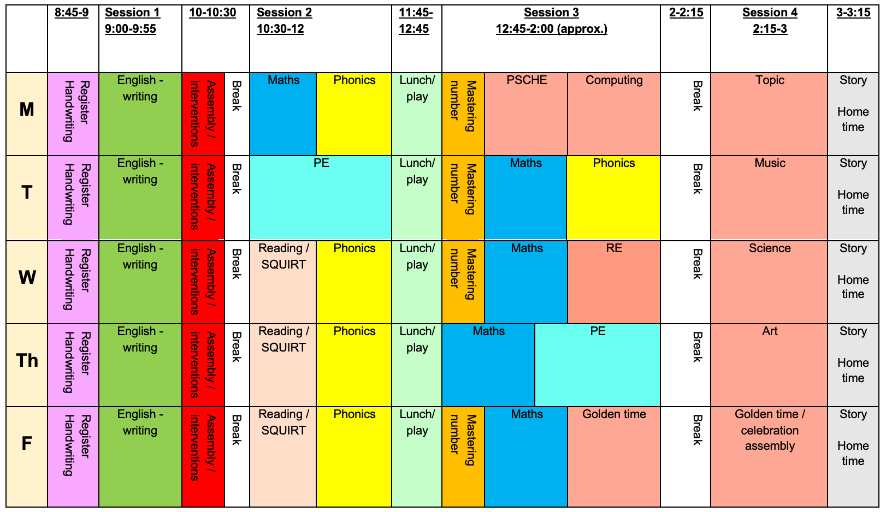
Timetable

Slide 8
Expectations
Always try their best
Be kind and respectful to everyone
Show good listening skills to staff / friends
Class Vision
We are positive and kind. We have fun, work hard and be the best we can be!

Slide 9
Equipment
Book Bags (everyday)
Water bottle (everyday) NO juice please
Appropriate coat for the weather

Slide 10
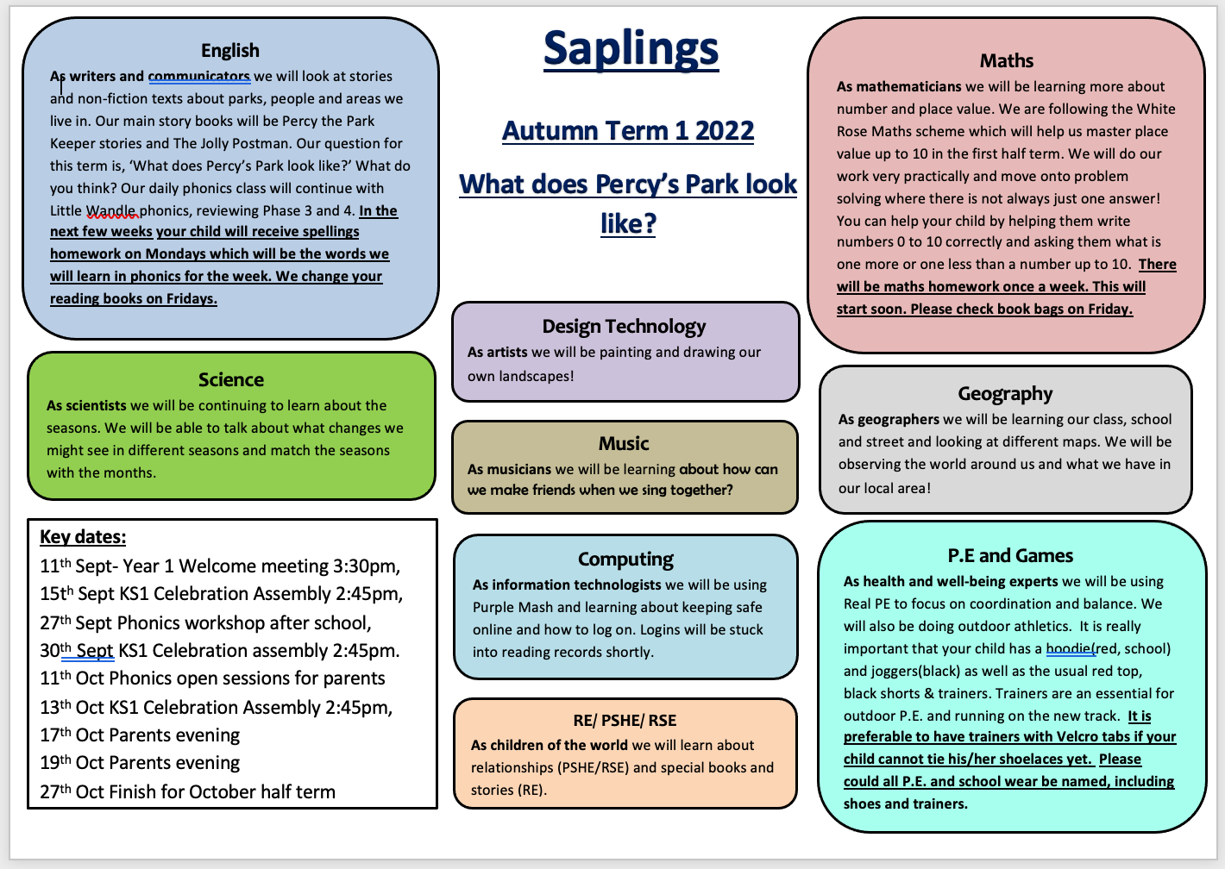
Curriculum Coverage

Slide 11
Children will be awarded Dojo points daily for things like being ready, being on task, contributing in lessons etc
You can get in contact with me via Dojo for any low level messages such as asking when PE is
Any other questions or queries need to be sent via email

Slide 12
Homework
Reading books sent home on a Friday.
Maths homework on a Friday.
Spelling homework on a Monday.

Slide 13
How you can help
Supporting with homework
Reading with your child – every day please!
Visiting the website for links
http://www.ripponden.calderdale.sch.uk/
Talking to your child about their learning
Keeping the lines of communication open – we have an open door policy and are here to help and support your child and your family where we can.

Slide 14
Medical/health needs
We hold a medical and health care needs register in school and this is treated with the strictest of confidence.
If your child has a medical need that we don’t know about, or if these needs change, please let us know as soon as possible. Please also make sure in date medication is sent into school.
To let us know, please email office@ripponden.calderdale.sch.uk for the attention of Miss Smith.

Slide 15
Any questions?
Please do ask if you have any questions.
If you have any questions about any of this, please get in touch with the office:
office@ripponden.calderdale.sch.uk
and a member of staff will get back to you as soon as possible.

