Slide 1
Welcome to Little Acorns
September 2023

Slide 2
Outline of this session: - to meet your child’s new class teacher - to share routines and expectations - information about how you can help support at home - how you can get in touch with us

Slide 3
Current position of school
The school went through a very rigorous Ofsted inspection in April and retained our ‘Good’ judgement.
In terms of data, the EYFS data is the strongest it has ever been and above local and national figures.
Year 4 Multiplication scores were significantly above national figures.
Outcomes at Key Stage 1 and Key Stage 2 are also very strong, with really good progress across Key Stage 1, and were at least in line with local and national figures and in some areas above.
We are in a great position to build on these successes this year!

Slide 4
School Priorities for 2023/24
To continue to improve writing outcomes for all children.
To develop oracy across the school.
To refine the mapping and development of the foundation subjects.

Slide 5
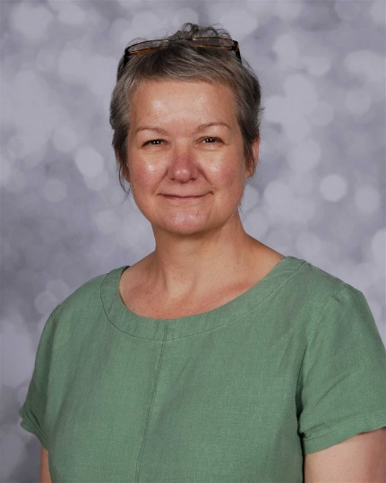
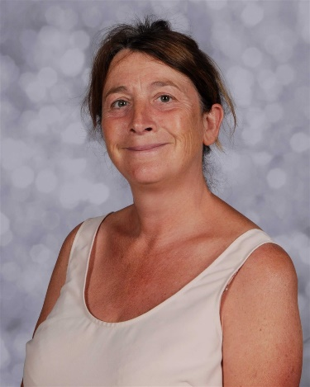
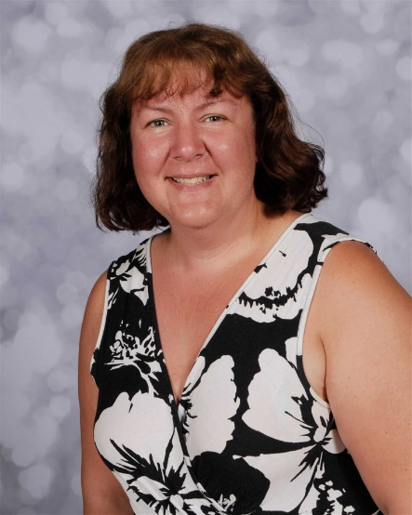
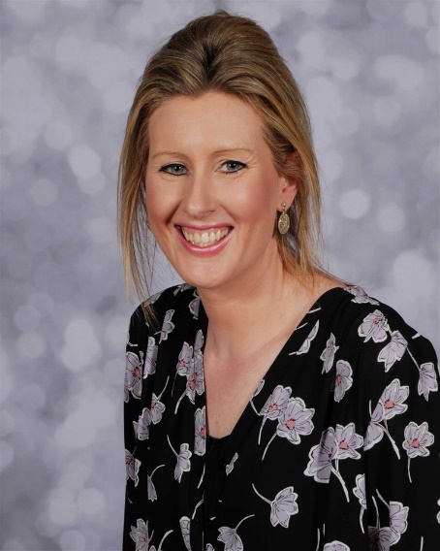
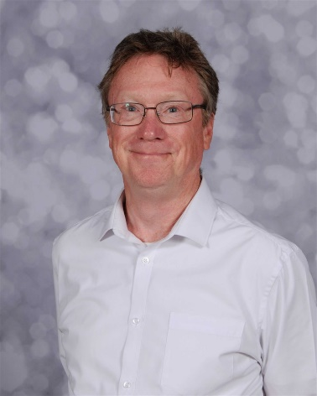
Meet the Team
Mrs Lizzie Greenwood
Teaching Assistant
Mrs Vicky Furnandiz
Teaching Assistant
Mrs Jude Kenny
Class Teacher
and
Assistant Headteacher
Mrs Andrea Whiteley
Cover Supervisor
Mr David Hanlon
Cover Supervisor

Slide 6
Who and when:
 | Morning |  | Afternoon
Monday | Mrs Kenny Mrs Furnandiz |  | Mrs Whiteley Mrs Greenwood
Tuesday | Mrs Kenny Mrs Furnandiz |  | Mrs Kenny Mrs Greenwood
Wednesday | Mrs Kenny Mrs Greenwood (9.00 – 10.30) Mrs Furnandiz |  | Mrs Kenny Mrs Greenwood
Thursday | Mrs Whiteley Mrs Greenwood (9.00 – 10.30) Mrs Furnandiz |  | Mrs Whiteley Mrs Greenwood
Friday | Mrs Kenny Mrs Greenwood (9.00 – 10.30) Mrs Furnandiz |  | Mrs Kenny Mrs Greenwood

Slide 7
Routines:
Every day is different in Little Acorns but we do have some daily routines and regular sessions which we need you to help us with:
Start of the day:
8.45 – 8.50
Gates are opened for the children’s arrival. We ask children to put their water bottles on the trolley and go into the classroom (after waving goodbye!). They take their own coat off and hang them on their peg then put their bookbag in one of the boxes in the classroom. They are all brilliant at doing this already!
8.50
Gates are locked – if you arrive after the gate has been locked you will need to take your child to the main office to be signed in. The office staff will then bring your child to the class and they will be marked late in the register.
Register – the register is taken electronically and the children will also do a self-register activity.
Morning session:
8.50 – 11.40
This is a mixture of whole class carpet time, small group work and accessing indoor and outdoor continuous provision. This session will include a daily phonics session.

Slide 8
Lunchtime:
11.45 – 12.30pm
The children are led over to the main school hall to eat their lunch. They line-up, collect their tray and cutlery then go to the serving hatch to be served their food by the kitchen staff. They then carry their own tray over to a table and sit down to eat lunch. There is always a member of lunchtime staff on duty to help them. As most of the children finish eating (approx. 12.00) they go out to play in the main school playground with KS1.
12.30pm
The children are collected from the playground and brought back to our classroom.
Afternoon session:
12.30pm – 2.45pm This is a mixture of whole class carpet time, small group work and accessing indoor and outdoor continuous provision. This session will include a daily maths session.
Hometime:
2.50pm – 3.00pm Book bags, coats, jumpers etc are given out as the children sit on the carpet. We endeavor to match everything up with the right children!
3.00pm - 3.10pm The children will be lined up at the gates ready to be collected. They are handed over 1 at a time to the known adult collecting them.

Slide 9
Timetable:
The first few weeks in Little Acorns are all about settling in, making new friends and exploring our fabulous setting and resources. After we have completed our initial assessments and established routines we will develop our timetable so that our sessions include daily phonics, maths and story sessions as well as whole class teaching times. I will post our regular daily timetable on the class page of the website as this becomes more firmly embedded.
 | 8.50 – 9.15 | 9.15 – 11.00 | 11.00 – 11.20 | 11.30 – 12.30 | 12.30 – 1.00 | 1.00 – 2.25 | 2.25 – 2.45 | 2.45 – 3.10
Monday | Whole class input | Continuous Provision, group work and snack* | Phonics | Lunchtime: 11.30 – 12.00 eating in the hall 12.00 – 12.30 playing in the KS1 playground | Whole class input | Continuous Provision, group work and snack | Story and singing time | Getting ready and home time
Tuesday |  |  | Phonics
Wednesday |  |  | Phonics
Thursday |  | PE | Phonics
Friday |  | * | Phonics |  |  |  |  | Celebration assembly every 2 weeks

Slide 10
Expectations
Our Little Acorns have big hearts and minds! We love learning, being kind and trying our best.

Slide 11
Equipment
Book bag every day – it is the best way to transport letters, pictures and reading books.
Reading book every day – this will be changed on a regular day each week (you will be advised of this when we start to send books home in the next week or so).
Spare underwear – please remember to send in a fresh, clean set if your child had an accident the day before and have used their spare set.
PE kit – this stays in school all the time and will be sent home every half term for washing and checking for size.
Water bottle every day – filled with fresh water (not juice thank you).
Coat appropriate for the weather – we do play out in all weathers!
Wellies – to be kept in school please.
Nothing else!

Slide 12
Curriculum Coverage

Slide 13
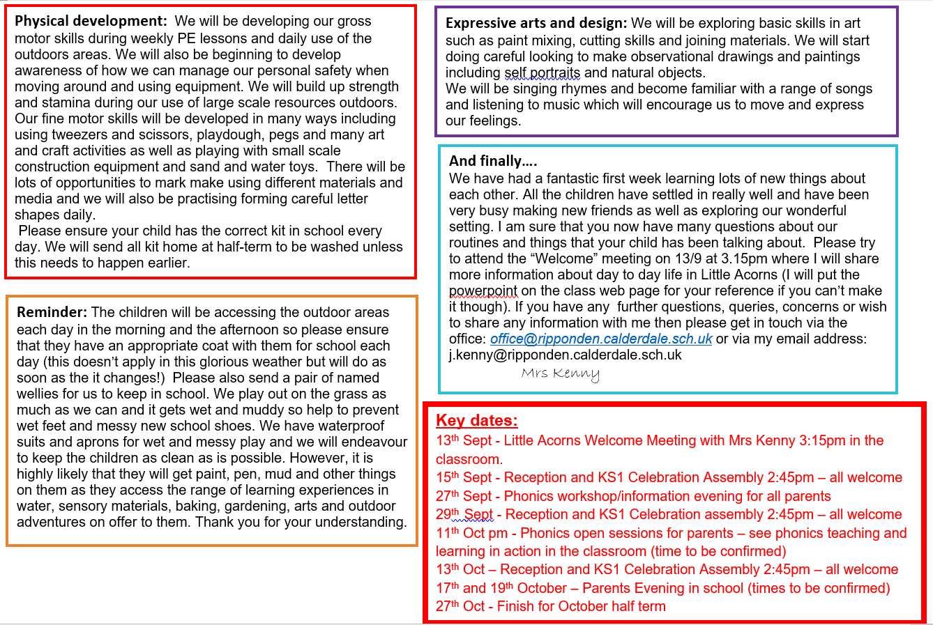

Slide 14
Homework
Reading and phonics.
Please read daily at home if you can!
When your child starts to bring home a reading book please hear them read it every day (or as often as you can).
Read lots and lots of other books to and with them as much as you possibly can! We send home a different “sharing” book from our class library every week. This is a book that your child has chosen from our selection in class specifically because they want to share it with their families at home. Please show your child how much you enjoy reading their choice of book to them.
Phonics books will be sent home with weekly phonics for you to practise with your child. These should be returned every Friday for new sounds to be added.
To find out more about how to help your child with early reading skills please attend our phonics workshop on:
Wednesday 27th September at 6.00pm

Slide 15
How you can help
Supporting with homework
Reading with your child – every day please!
Visiting the website for links
http://www.ripponden.calderdale.sch.uk/
Talking to your child about their learning
Keeping the lines of communication open – we have an open door policy and are here to help and support your child and your family where we can.

Slide 16
How you can help

Slide 17
Medical/health needs
We hold a medical and health care needs register in school and this is treated with the strictest of confidence.
If your child has a medical need that we don’t know about, or if these needs change, please let us know as soon as possible. Please also make sure in date medication is sent into school.
To let us know, please email office@ripponden.calderdale.sch.uk for the attention of Miss Smith.

Slide 18
Any questions?
We are delighted to be able to meet you face-to-face today. Please do ask if you have any questions.
If you have any questions about any of this, please get in touch with the office:
office@ripponden.calderdale.sch.uk
and a member of staff will get back to you as soon as possible.

Slide 19
A couple of other things:
Snack money
Assemblies and certificates
Wellies
Busy Bees
Water bottles
PTFA

